Slide 1
IBS Vietnam dress code
Ver.2 ~ 9 April 2015
Intelligence Business Solutions Vietnam

Slide 2
Why we need dress code?
Because, our company isn’t usual software company. We have to implement 1.Recruitment services, 2 Business consulting and 3.Global team.
Key word
Reasons
Recruitment services
INTELLIGENCE group's primary business is “Recruitment Service”. This service’s staff (Recruitment Adviser / Career Consultant) have to have clean and polite image. That’s why, almost staff have suit or business casual. This is a group basic culture. Please follow this culture even if we are in Vietnam, because we are same team.
Business consulting
IBS has 3 kinds of service domain. 1.Business Consulting 2.System Integration 3.IT Outsourcing. In the near future you might be a business consultant in Asian countries. If you target next stage, you should keep good appearance from now on.
Global team
In 5 years, we will open several global team office in Asia. Vietnam office is the 1st office. We will be a role model of global team. If students living in Asian countries find our staff who has good appearance and high IT skill, the students might join our company. We have to be admiration of Asian countries IT engineer.

Slide 3
Dress code of Vietnam office
You have to keep below rules. Especially don’ts rules. If you have any questions, please ask to admin or director.
Gender | Items | Do’s | Don’ts
Male | Tops | dress shirt | T-shirt, tank top Don’t your shirt bottom outside of pants
 | Bottoms | Trousers, chino pants | Jeans, Short pants
 | Shoes | Leather shoes | Sandals, Sneakers
 | Socks | Black, White | No socks, Color socks
Female | Tops | n/a | Sleeveless dress, Gaudy dress, T-shirts
 | Bottoms | n/a | Gaudy dress, Jeans
 | Shoes | Leather shoes, pumps | Sandals, Sneakers
 | Socks | n/a | Gaudy dress

Slide 4
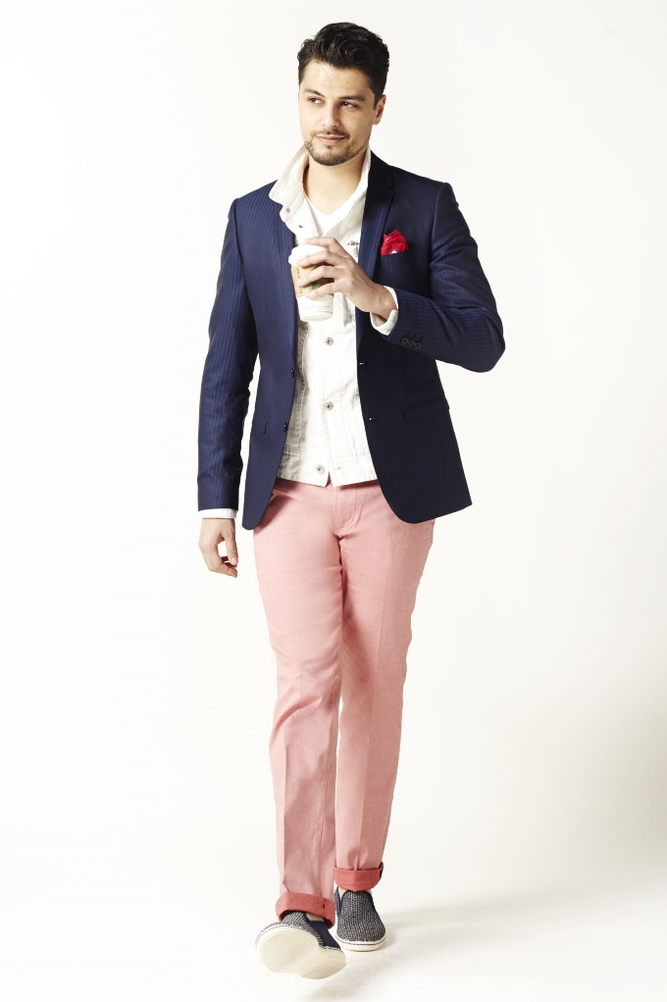
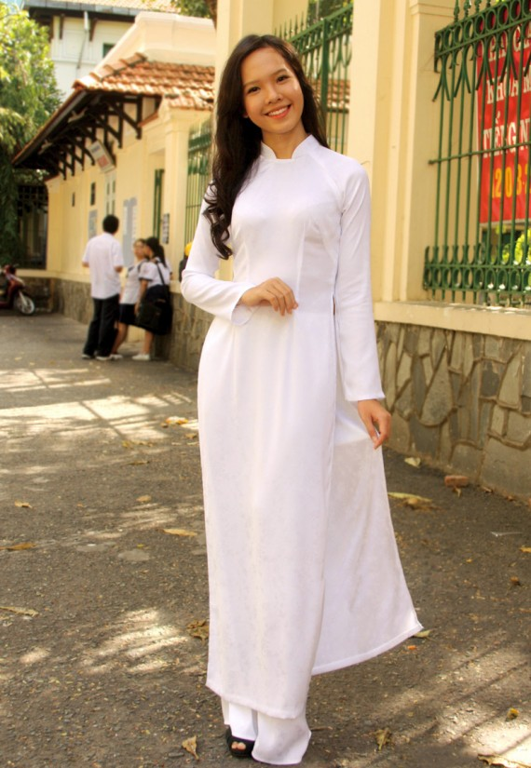
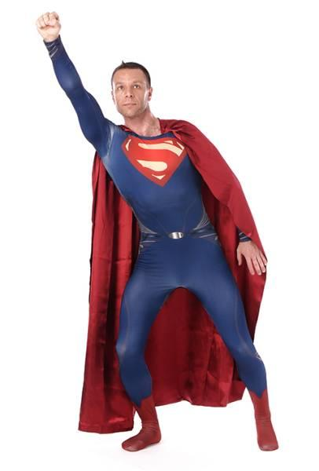
Free Cloth Friday
However, only Friday we allow to wear any cloth.

Slide 5
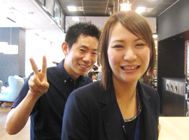

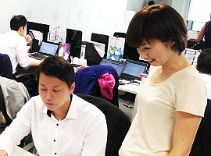
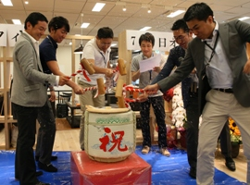
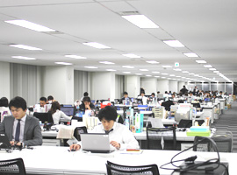

Please enjoy our dress code
Our group company’s slogan is “Your Job, Your Joy”. All group employees are enjoying dress code. However, It isn’t easy. Because, there are some rules and you have to have high fashion sense.

